Slide 1
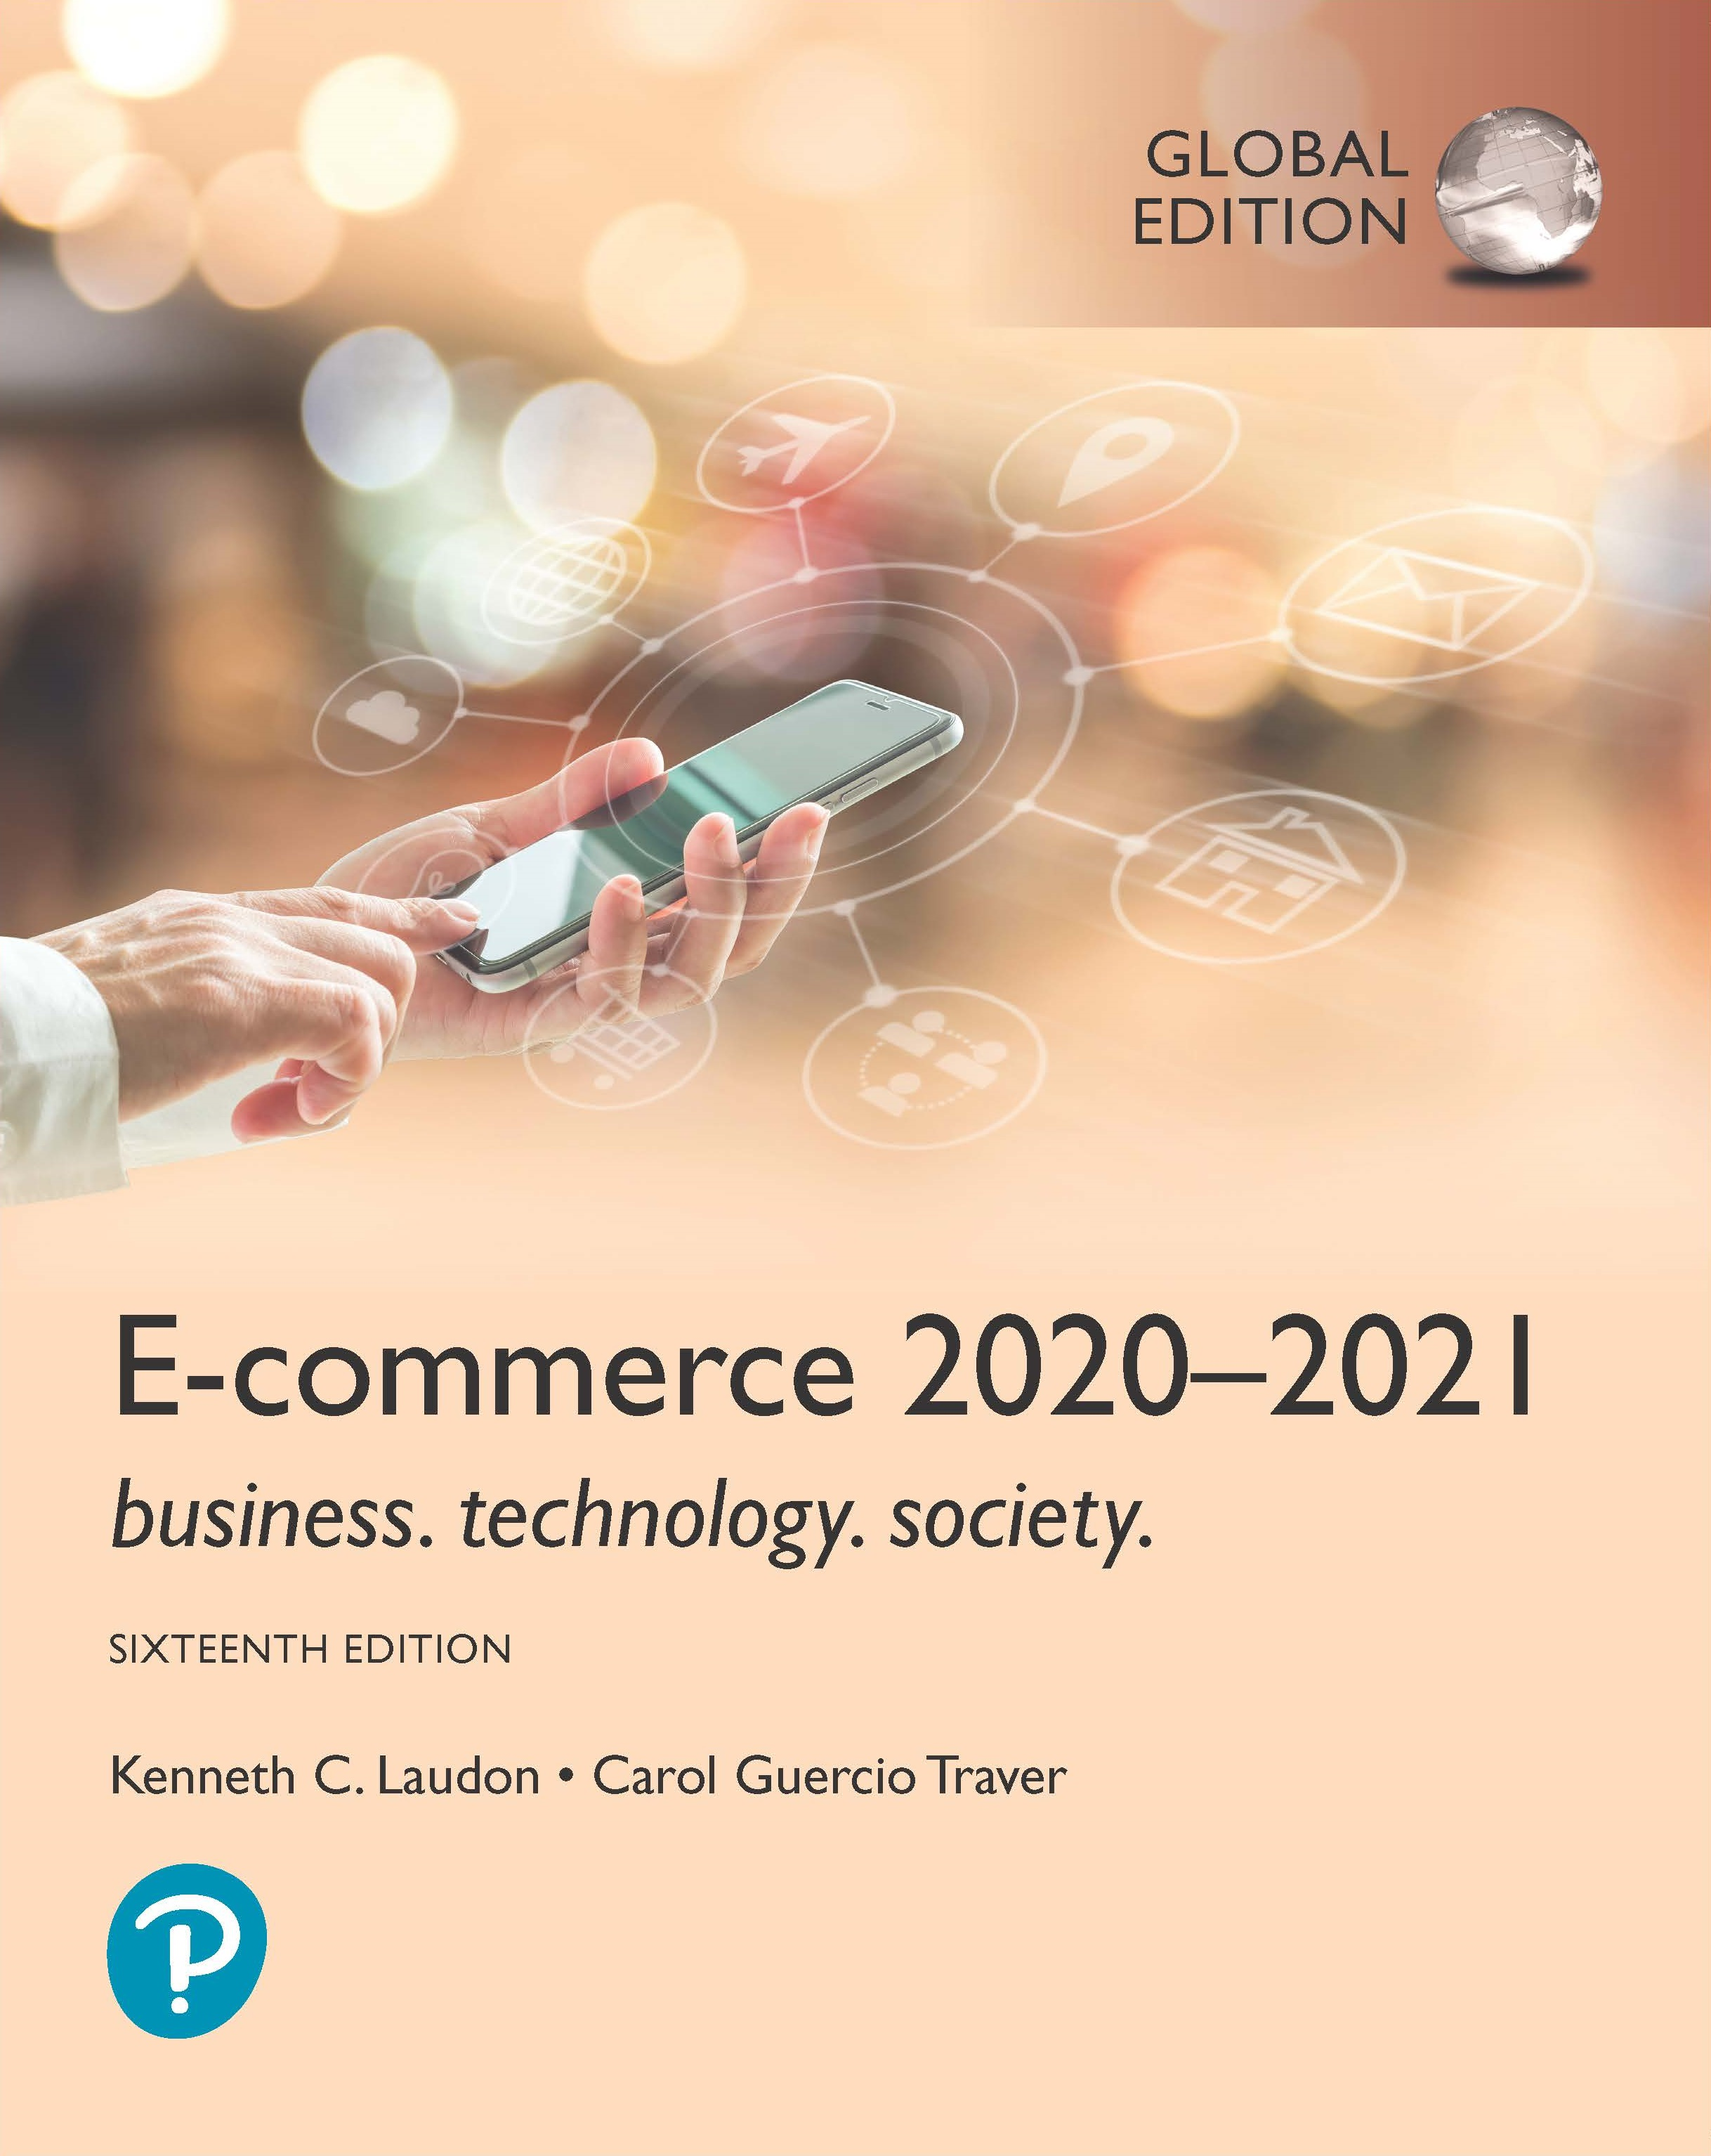
E-commerce 2020-2021: Business. Technology. Society.
Sixteenth Edition, Global Edition
Chapter 2
E-commerce Infrastructure
Slides in this presentation contain hyperlinks. JAWS users should be able to get a list of links by using INSERT+F7
Copyright © 2021 Pearson Education Ltd. All Rights Reserved
Notes:
If this PowerPoint presentation contains mathematical equations, you may need to check that your computer has the following installed:
1) MathType Plugin
2) Math Player (free versions available)
3) NVDA Reader (free versions available)

Slide 2
Learning Objectives
2.3 Understand how the Web works.
2.4 Describe how Internet and web features and services support e-commerce.
2.5 Understand the impact of mobile applications.
Notes:
Slide 2 is list of textbook LO numbers and statements

Slide 3
The Web
1989–1991: Web invented
Tim Berners-Lee at C E R N
H T M L, H T T P, web server, web browser – the 4 essential components of the Web
1993: Mosaic web browser w/G U I
Andreessen and others at N C S A
Runs on Windows, Macintosh, or Unix
1994: Netscape Navigator, first commercial web browser
1995: Microsoft Internet Explorer, Netscape’s market share fell from 100% to 0.5%
Notes:
CERN – European Council for Nuclear Research.
NCSA – National Centre for Supercomputing Applications

Slide 4
Hypertext
Text formatted with embedded links
Links connect documents to one another, and to other objects such as sound, video, or animation files
Uses Hypertext Transfer Protocol (H T T P) and U R L s to locate resources on the Web
Example U R L: http://megacorp.com/content/features/082602.html
Notes:
Note: Example URL is not an actual URL.

Slide 5
Markup Languages
Hypertext Markup Language (H T M L)
Fixed set of pre-defined markup “tags” used to format text
Controls look and feel of web pages
Used in conjunction with Cascading Style Sheets (C S S)
H T M L5 the newest version
eXtensible Markup Language (X M L)
Designed to describe data and information
Tags used are defined by user

Slide 6
Web Servers and Web Clients
Web server software
Enables a computer to deliver web pages to clients on a network that request this service by sending an H T T P request
Basic capabilities: Security services, F T P, search engine, data capture
Web server
May refer to either web server software or physical server
Specialized servers: Database servers, ad servers, and so on
Web client
Any computing device attached to the Internet that is capable of making H T T P requests and displaying H T M L pages

Slide 7
Web Browsers
Primary purpose is to display web page, but may include added features
Google’s Chrome: more than 67% and 64% of the desktop and mobile markets, respectively
Open source
Internet Explorer: 8% of desktop, >1% mobile
Microsoft Edge: 5% of desktop
Mozilla Firefox: 9% desktop, >1% mobile
Open source
Apple’s Safari: 4% desktop, 27% mobile

Slide 8
The Internet and Web: Features
Features on which the foundations of e-commerce are built:
Communication tools
Search engines
Downloadable and streaming media
Web 2.0 applications and services
Virtual reality and augmented reality
Intelligent digital assistants

Slide 9
Communication Tools
E-mail
Most used application of the Internet
Messaging Applications
Instant messaging
Online message boards – also referred to as forum, bulletin board, discussion board
Internet telephony – a general term for the technologies that use V O I P
Video conferencing, video chatting, telepresence
Notes:
Telepresence takes video conferencing up several notches. Rather than single persons “meeting” by using webcams, telepresence creates an environment in a room using multiple cameras and screens, which surround the users.

Slide 10
Search Engines
Identify web pages that match queries based on one or more techniques
Keyword indexes
Page ranking
Also serve as:
Shopping tools
Advertising vehicles (search engine marketing)
Tool within e-commerce sites
Top three providers: Google, Bing, Yahoo (Oath)
Other European search providers include T-Online(Germany) , Qwant(France)
Chinese include Baidu, Qihoo, Sohu

Slide 11
Figure 2.17 How Google Works
Notes:
Figure 2.17, page 167.
Full description: An image shows how Google works, in terms of indexing the Web and processing a search query. The steps are as follows for A, Indexing the Web. 1. A Google bot, a form of software code, crawls the Web, going from link to link. 2. Crawled pages are analyzed: links, semantic analysis and JavaScript or C S S content. 3. New data is added to an index of keywords and the pages on which they appear. 4. To deal with the scale of the Web, Google has already indexed an estimated 30 trillion pages. Google breaks it up into thousands of index shards, groups of millions of pages. 5. The index shards are stored on Google servers, of which there are approximately 1 million, located in data centers around the world. 6. The indexing process runs continuously, processing billions of Web pages a day. Pages with frequently updated content and links from other highly ranked sites are crawled more regularly and deeply, and given higher rank themselves. The steps are as follows for B, Processing a Search Query. 1. A user enters a search query on a desktop computer or mobile device. Google will make suggestions as the user types. 2. The search request is sent to one of Google's many servers. 3. The server uses an algorithm to access the index database, find matching pages, and compute a score, representing how good a match the page is for query. The algorithm has 200 plus variables including PageRank, the quality and relevance of the content on the page to the query the context of the search and the user's previous search history. Google also applies various penalties and filters to prevent attempts to game the algorithm. 4. Small text summaries, or snippets, are generated for each result. 5. Results delivered to the user, 10 to a page.

Slide 12
Downloadable and Streaming Media
Downloads:
Growth in broadband connections enables large media file downloads
Streaming technologies
Enables music, video, and other large files to be sent to users in chunks so that the file can play uninterrupted
Podcasting
Explosion in online video viewing

Slide 13
Web 2.0 Features and Services
Online Social Networks
Services that support communication among networks of friends, peers
Blogs
Personal web page of chronological entries
Enables web page publishing with no knowledge of H T M L
Wikis
Enables documents to be written collectively and collaboratively
E.g. Wikipedia

Slide 14
Virtual Reality and Augmented Reality
Virtual reality (V R)
Immersing users within virtual world
Typically uses head-mounted display (H M D)
Oculus Rift, Vive, PlayStation V R
Augmented reality (A R)
Overlaying virtual objects over the real world, via mobile devices or H M D s
Pokémon G O

Slide 15
Intelligent Digital Assistants
Computer search engine using:
Natural language
Conversational interface, verbal commands
Situational awareness
Can handle requests for appointments, flights, routes, event scheduling, and more.
Examples:
Apple’s Siri
Google Now
Google Assistant
Amazon’s Alexa
Microsoft’s Cortana

Slide 16
Mobile Apps
Use of mobile apps has exploded
Most popular entertainment media, over T V
Always present shopping tool
Almost all top 100 brands have an app
Platforms
iPhone/iPad (i O S), Android
App marketplaces
Google Play, Apple’s App Store, Amazon’s Appstore

Slide 17
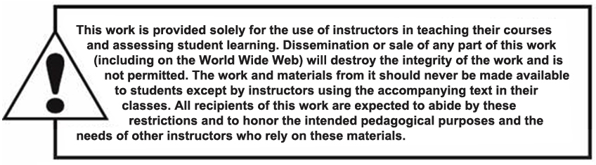
Copyright

